Slide 1

Original Article Intravascular Imaging–Guided or Angiography-Guided Complex PCI
Joo Myung Lee, M.D., Ph.D., M.P.H., Ki Hong Choi, M.D., Ph.D., Young Bin Song, M.D., Ph.D., Jong-Young Lee, M.D., Ph.D., Seung-Jae Lee, M.D., Ph.D., Sang Yeub Lee, M.D., Ph.D., Sang Min Kim, M.D., Ph.D., Kyeong Ho Yun, M.D., Ph.D., Jae Young Cho, M.D., Ph.D., Chan Joon Kim, M.D., Ph.D., Hyo-Suk Ahn, M.D., Ph.D., Chang-Wook Nam, M.D., Ph.D., Hyuck-Jun Yoon, M.D., Ph.D., Yong Hwan Park, M.D., Ph.D., Wang Soo Lee, M.D., Ph.D., Jin-Ok Jeong, M.D., Ph.D., Pil Sang Song, M.D., Ph.D., Joon-Hyung Doh, M.D., Ph.D., Sang-Ho Jo, M.D., Ph.D., Chang-Hwan Yoon, M.D., Ph.D., Min Gyu Kang, M.D., Ph.D., Jin-Sin Koh, M.D., Ph.D., Kwan Yong Lee, M.D., Ph.D., Young-Hyo Lim, M.D., Ph.D., Yun-Hyeong Cho, M.D., Ph.D., Jin-Man Cho, M.D., Ph.D., Woo Jin Jang, M.D., Ph.D., Kook-Jin Chun, M.D., Ph.D., David Hong, M.D., Taek Kyu Park, M.D., Ph.D., Jeong Hoon Yang, M.D., Ph.D., Seung-Hyuk Choi, M.D., Ph.D., Hyeon-Cheol Gwon, M.D., Ph.D., Joo-Yong Hahn, M.D., Ph.D., for the RENOVATE-COMPLEX-PCI Investigators
N Engl J Med
Volume 388(18):1668-1679
May 4, 2023

Slide 2
Study Overview
In a randomized trial of imaging-guided or angiography-guided PCI for complex coronary lesion revascularization procedures, imaging-guided PCI led to a lower risk of target-vessel failure than angiography-guided PCI.

Slide 3
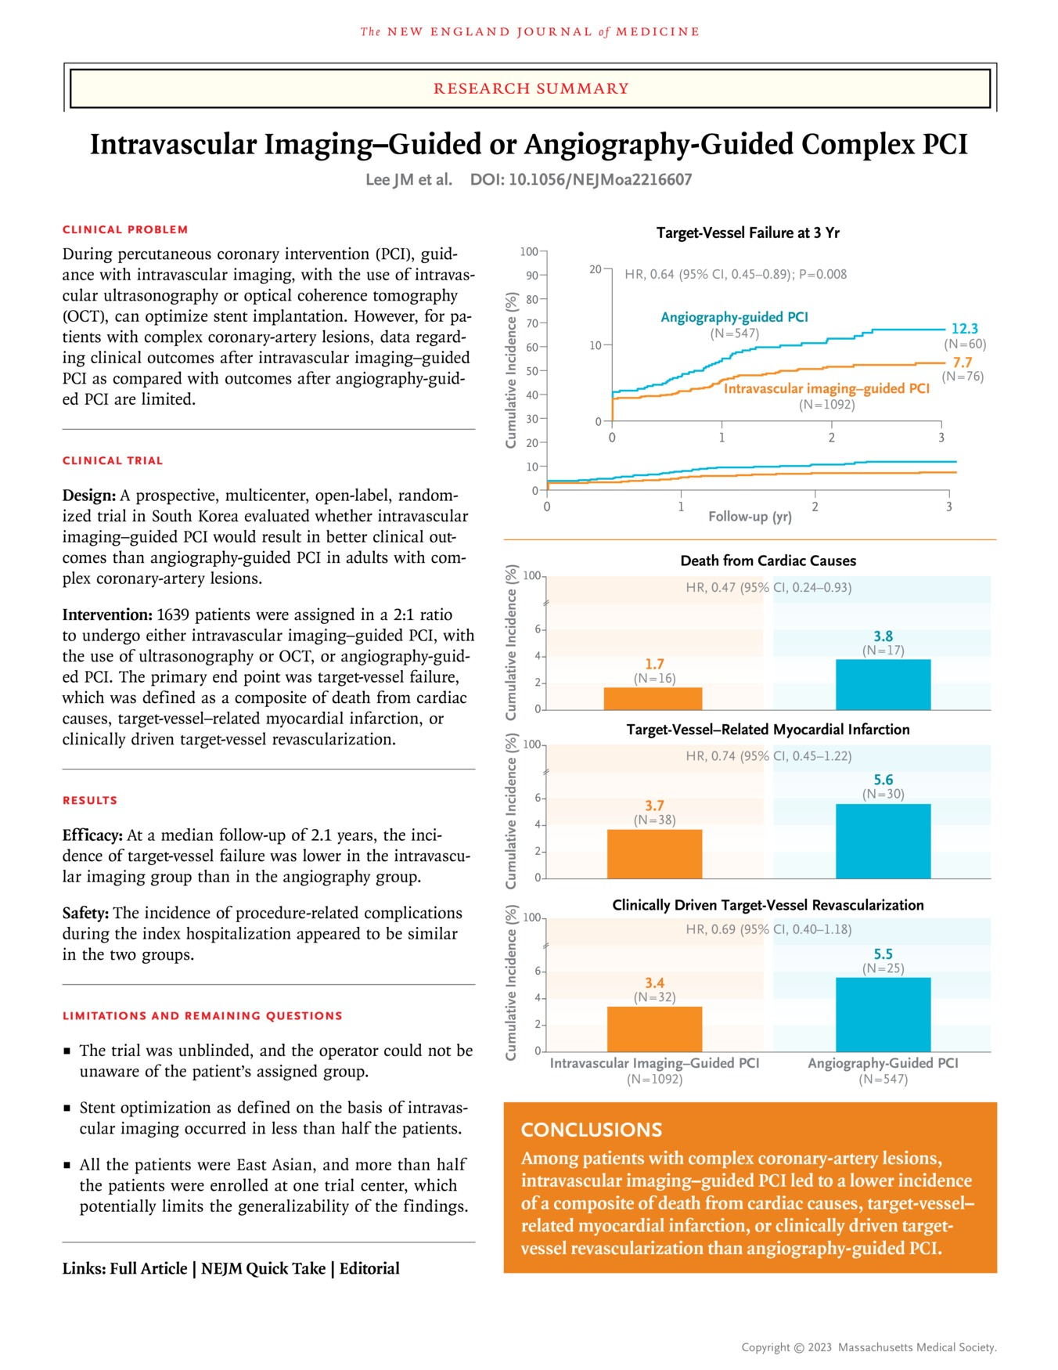
Lee JM et al. N Engl J Med2023;388:1668-1679
Notes:
Download a PDF of the Research Summary.

Slide 4
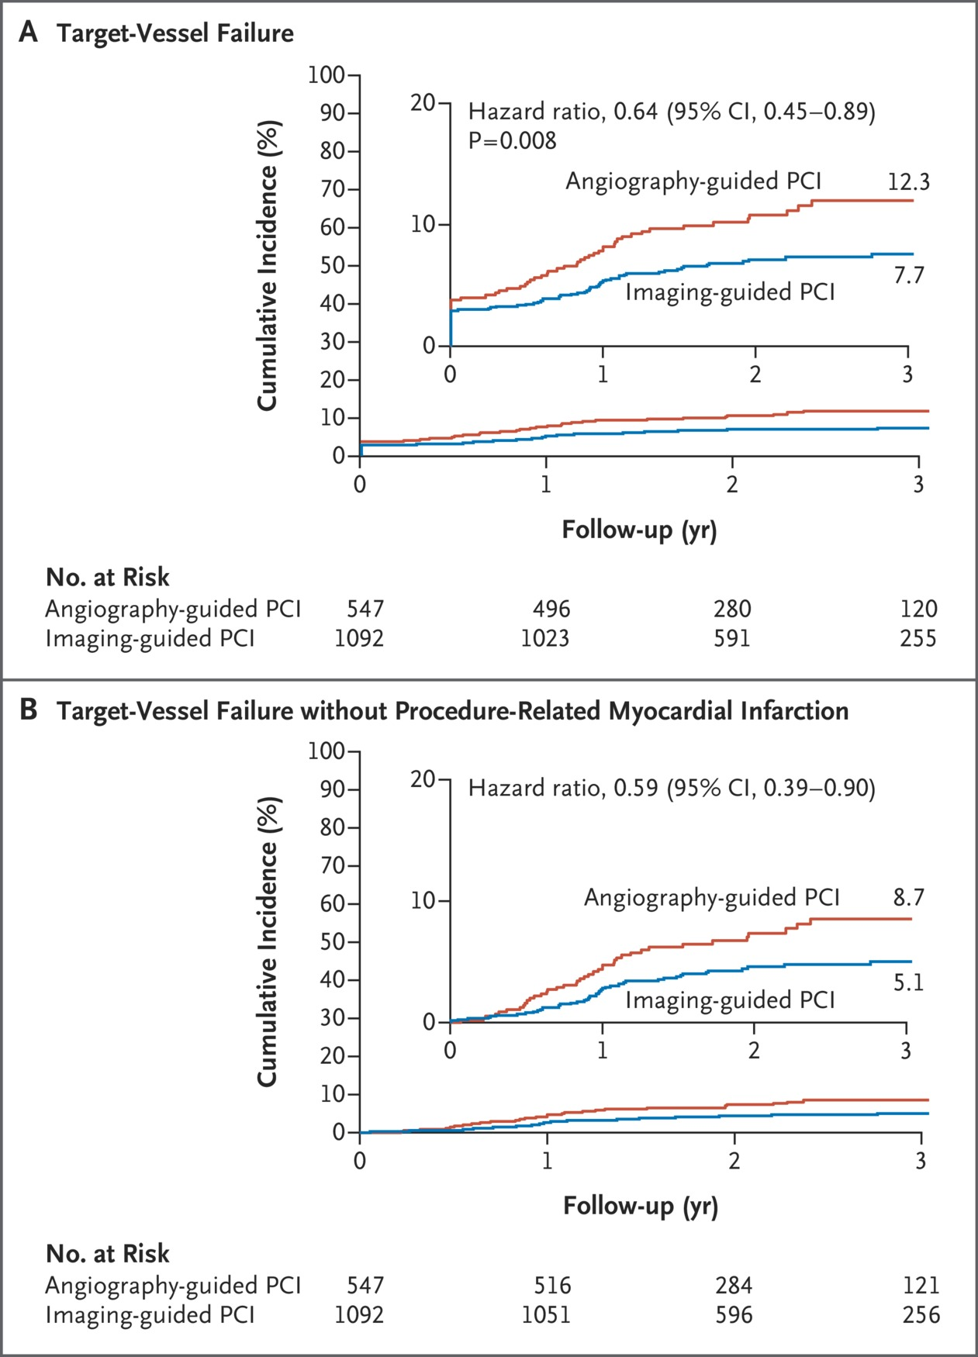
Cumulative Incidences of Trial End Points.
Lee JM et al. N Engl J Med2023;388:1668-1679
Notes:
Figure 1 Cumulative Incidences of Trial End Points. The primary end point was target-vessel failure, which was defined as a composite of death from cardiac causes, target-vessel–related myocardial infarction, or clinically driven target-vessel revascularization in the intention-to-treat population during the overall trial period (i.e., from the time of randomization to the day of the first occurrence of a primary end-point event, the day of the last office or telephone visit, or the day of death during follow-up) (Panel A). The primary end-point analysis included an estimation of the cumulative risk of target-vessel failure and a comparison of the randomized groups with the method of Fine and Gray to adjust for the potential competing risk of death from noncardiac causes. Therefore, the hazard ratios are subhazard ratios from a competing-risk analysis. The secondary end point of target-vessel failure without procedure-related myocardial infarction was compared between the two trial groups (Panel B). In both panels, percentages are cumulative incidences at 3 years and therefore may not calculate as expected. Insets in both panels show the same data on enlarged y axes. PCI denotes percutaneous coronary intervention.

Slide 5
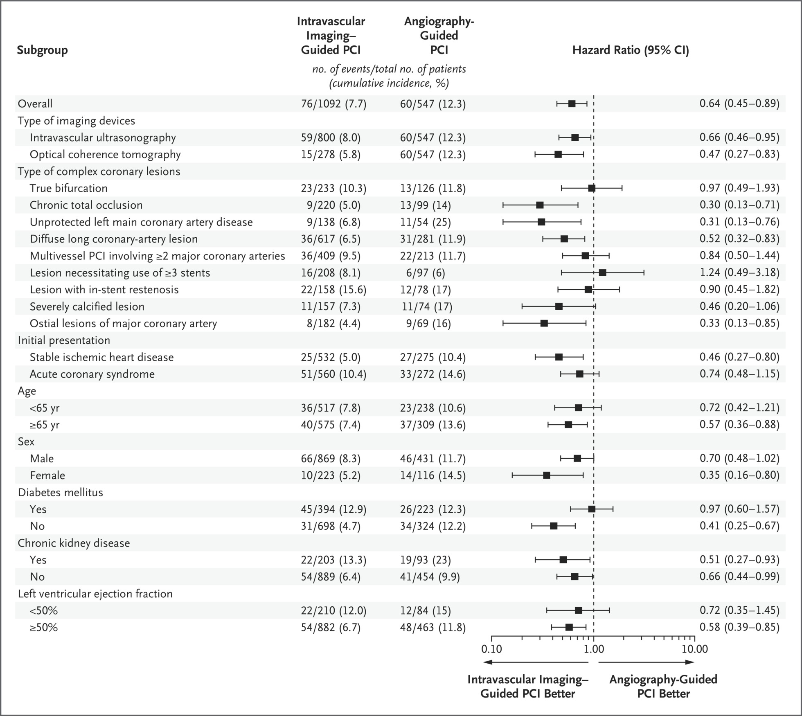
Prespecified Subgroup Analysis of the Primary End Point.
Lee JM et al. N Engl J Med2023;388:1668-1679
Notes:
Figure 2 Prespecified Subgroup Analysis of the Primary End Point. The hazard ratio for the primary end point (composite of death from cardiac causes, target-vessel–related myocardial infarction, or clinically driven target-vessel revascularization) was calculated in the subgroups defined according to the choice of intravascular imaging device (intravascular ultrasonography or optical coherence tomography [OCT]), type of complex coronary lesion, initial presentation (stable ischemic heart disease or acute coronary syndrome), age (<65 years or ≥65 years), sex, presence or absence of diabetes mellitus, presence or absence of chronic kidney disease, and left ventricular ejection fraction (<50% or ≥50%). In the subgroup analysis according to the type of imaging device, the reference group of patients in the angiography group who had a primary end-point event was used. Percentages are cumulative incidences at 3 years and therefore may not calculate as expected. The hazard ratio for the primary end point in the overall population was derived from a competing-risk analysis. Other analyses in the prespecified subgroup analysis were derived from a Cox proportional-hazards regression model. Because the statistical analysis plan did not include a provision for correcting for multiplicity when conducting tests for secondary end points, results are reported as point estimates with 95% confidence intervals. The widths of the confidence intervals have not been adjusted for multiplicity, so they should not be used to infer definitive treatment effects for secondary end points.

Slide 6
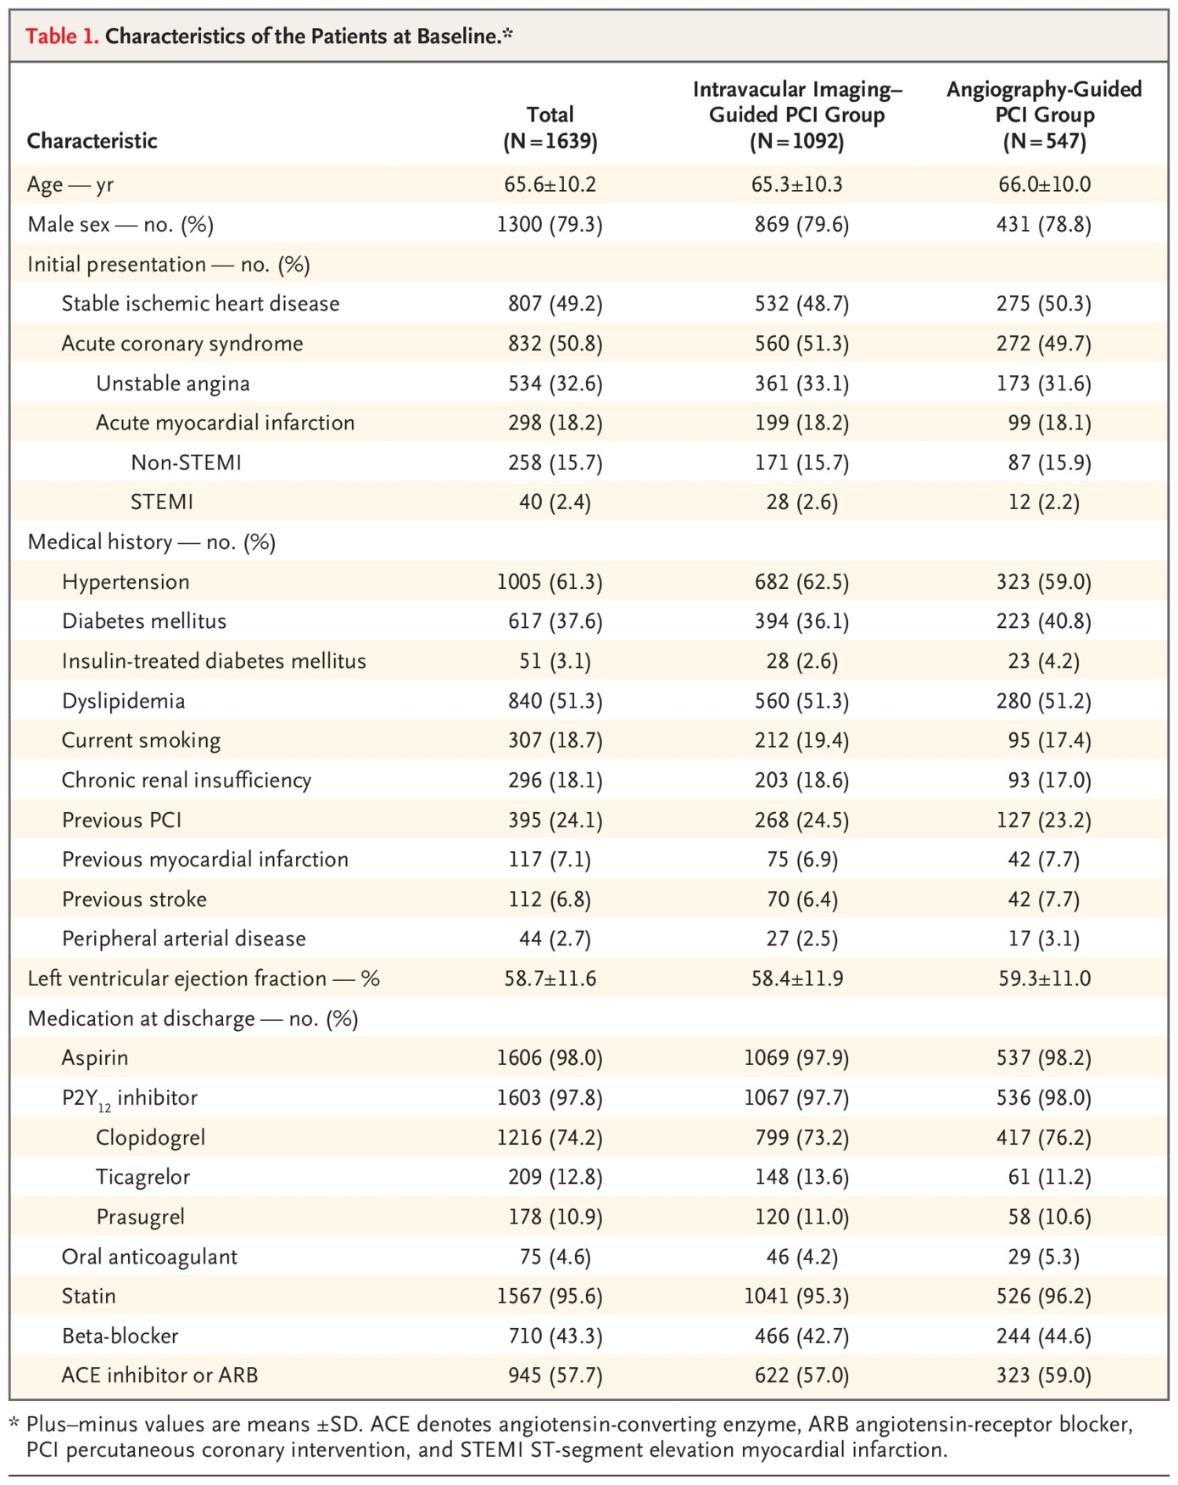
Characteristics of the Patients at Baseline.
Lee JM et al. N Engl J Med2023;388:1668-1679
Notes:
Table 1 Characteristics of the Patients at Baseline.

Slide 7
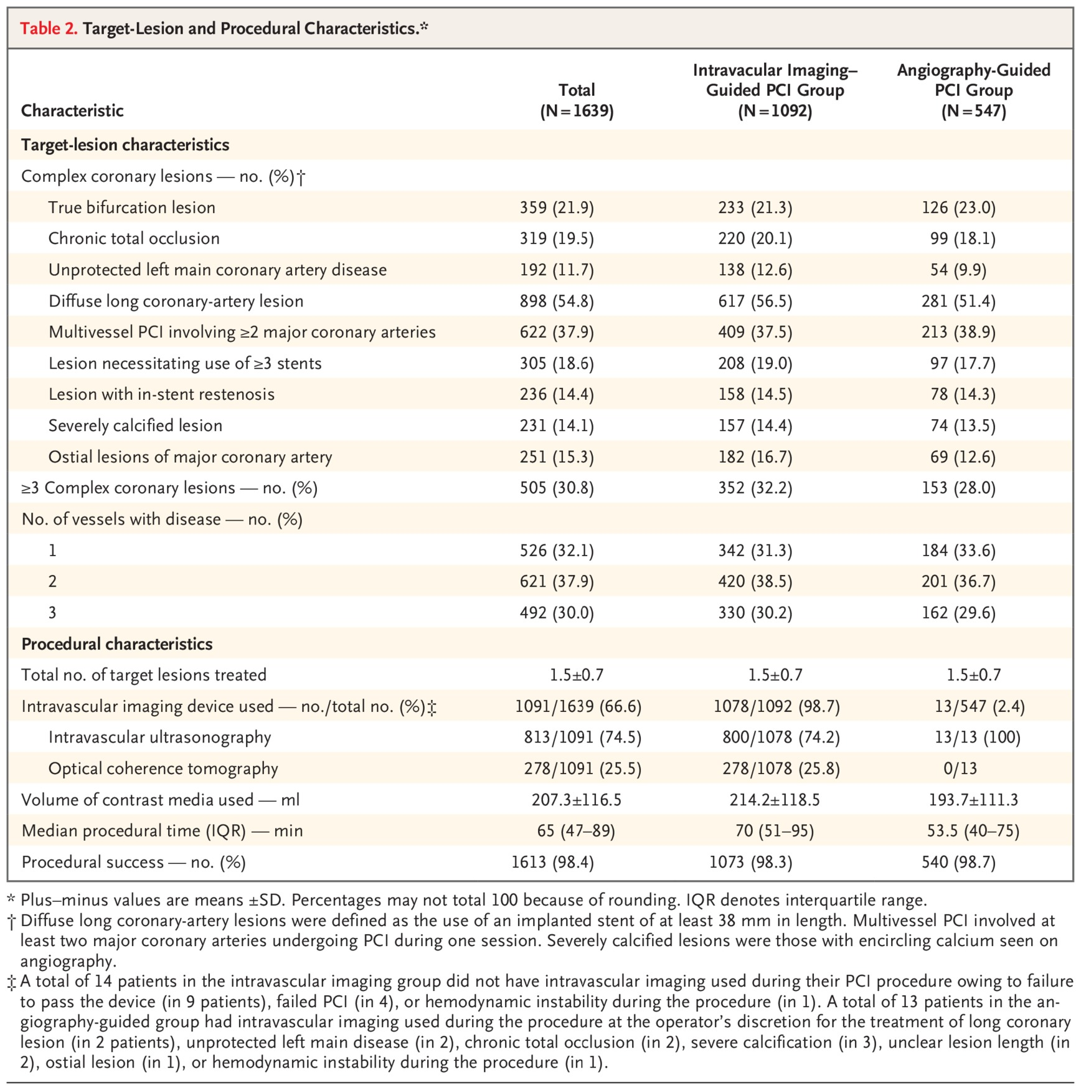
Target-Lesion and Procedural Characteristics.
Lee JM et al. N Engl J Med2023;388:1668-1679
Notes:
Table 2 Target-Lesion and Procedural Characteristics.

Slide 8
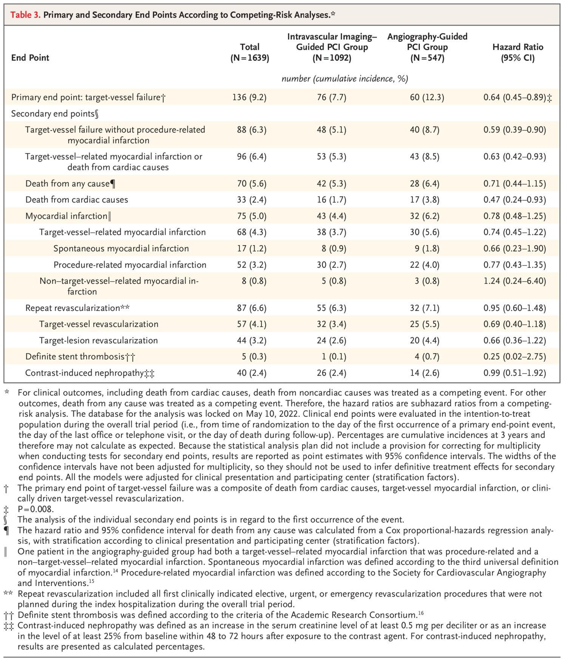
Primary and Secondary End Points According to Competing-Risk Analyses.
Lee JM et al. N Engl J Med2023;388:1668-1679
Notes:
Table 3 Primary and Secondary End Points According to Competing-Risk Analyses.

Slide 9
Conclusions
Among patients with complex coronary-artery lesions, intravascular imaging–guided PCI led to a lower risk of a composite of death from cardiac causes, target-vessel–related myocardial infarction, or clinically driven target-vessel revascularization than angiography-guided PCI.
(Supported by Abbott Vascular and Boston Scientific; RENOVATE-COMPLEX-PCI ClinicalTrials.gov number, NCT03381872).

